Slide 1
T32 Program Directors Meeting
November 14, 2023

Slide 2
Agenda
Updates/reminders
DEIA discussion with Dr. Albert Avila
Report from TGM Collaboration Break-out

Slide 3
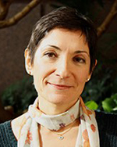
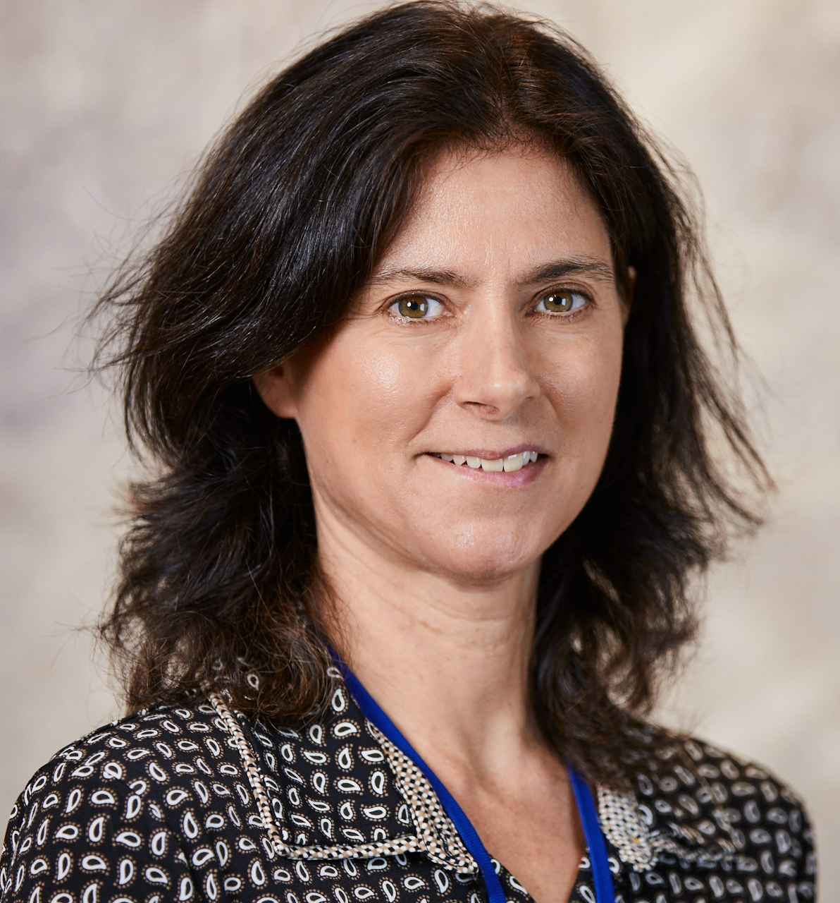
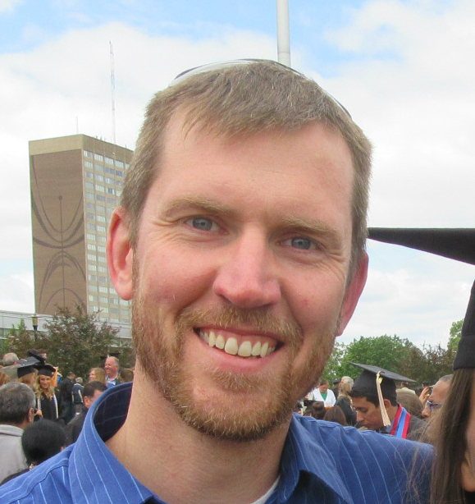
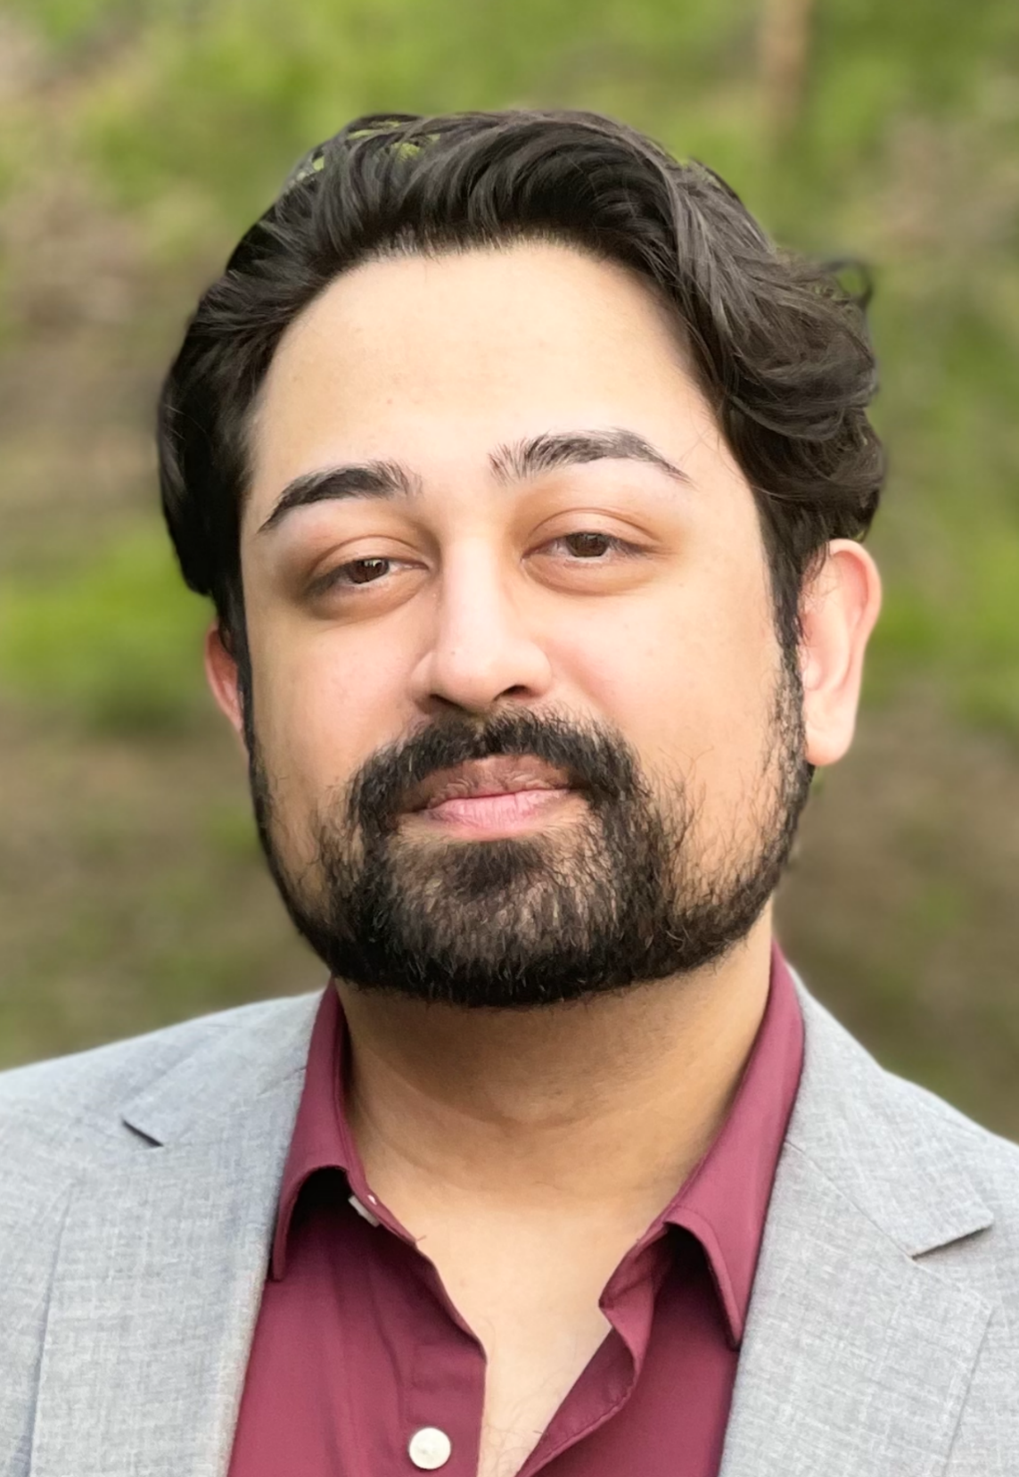
DIDT Team
Zeynep Erim, PhD
Director
Tina Gatlin, PhD
Program Director
Dave Gutekunst, PhD
Program Director
Khalil Chughtai, BS
Scientific Program Analyst
https://www.nibib.nih.gov/training-careers
https://www.nibib.nih.gov/research-funding/division-of-interdisciplinary-training-didt

Slide 4

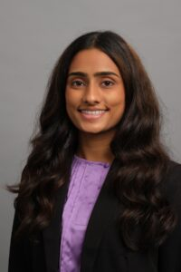
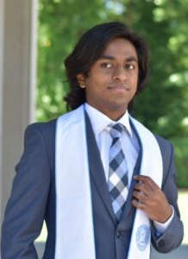




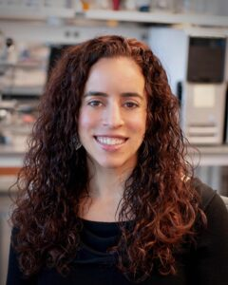
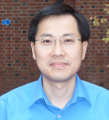
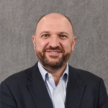
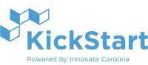



The Unified Medical Ultrasound Technology Development (UNMUTED) Predoctoral T32 Training Program
Roshni Gandhi
Shureed Qazi
Caterina Gallippi (JBME)
Director
Xiaoning Jiang (NCSU MAE)
Associate Director
Omer Oralkan (NCSU ECE)
Associate Director
Notes:
SA1:
Clinical shadowing
Clinical mentor
SA2:
Engineering Ph.D. curriculum
Monthly ultrasound seminar series, annual research retreat
Ultrasound research mentor
SA3:
NSF I-Corps training program
Two commercialization classes (Fundamentals of Technology Commercialization and Research to Revenue: University Startups)
Design-thinking workshops with Siemens Healthineers
SBIR proposal and business plan preparation (mentored)
Summer internship in ultrasound industry
Commercialization mentor

Slide 5

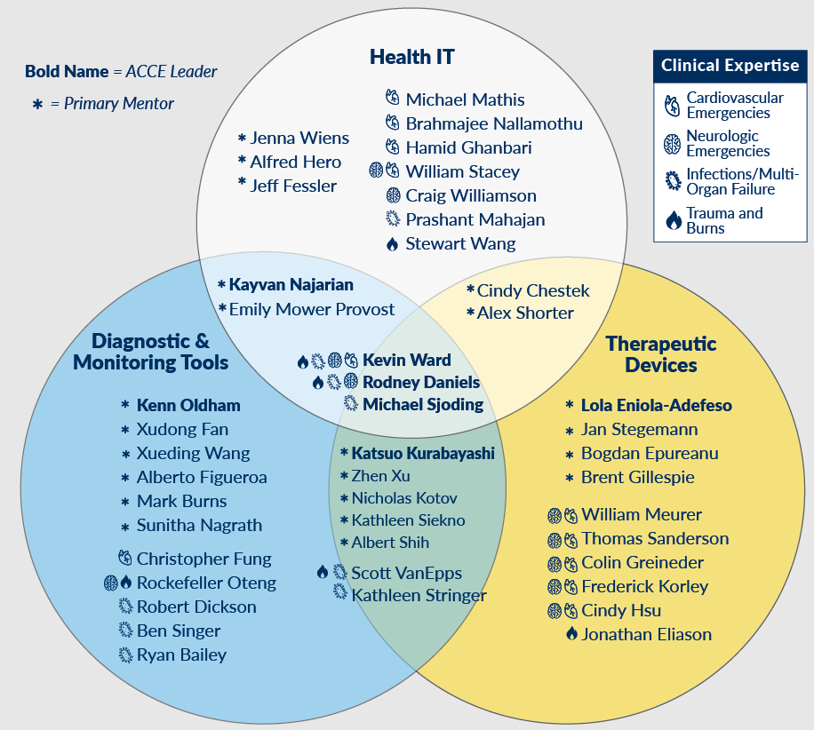
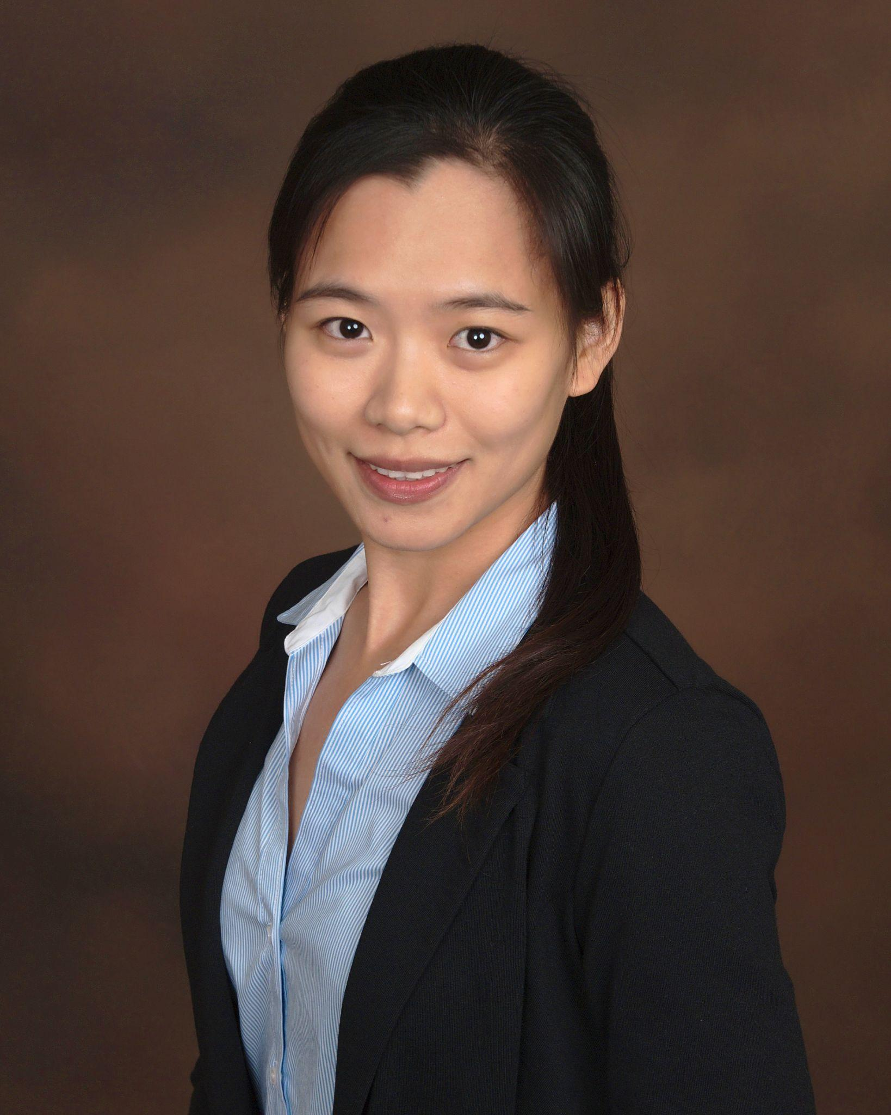
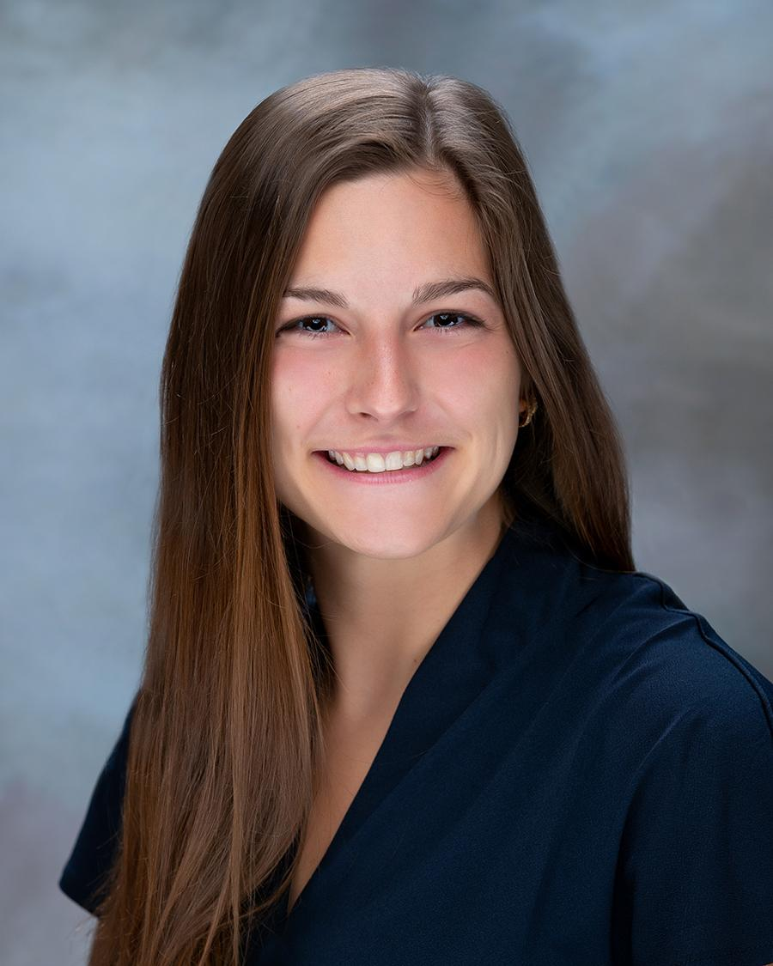
Two-year program for mid-stage Ph.D. students in engineering and related fields
Mentoring network
Acute and Critical Care Engineering Training Program
PI: Prof. Kenn Oldham, Mechanical Engineering
Co-PI: Dr. Kevin Ward, Emergency Medicine and Biomedical Engineering
Attributes of technology for critical care
Highly time-sensitive
Often required outside hospital setting
Often involve physiological systems
May feature pathophysiological commonalities
Primary program components
Multidisciplinary mentorship
Design studio
Translation and commercialization training
Relevant coursework
Clinical immersion program
Supporting events
Inaugural Trainees
Lingrui Cai Lucy Spicher
Traumatic Fetal
brain monitoring
injury

Slide 6
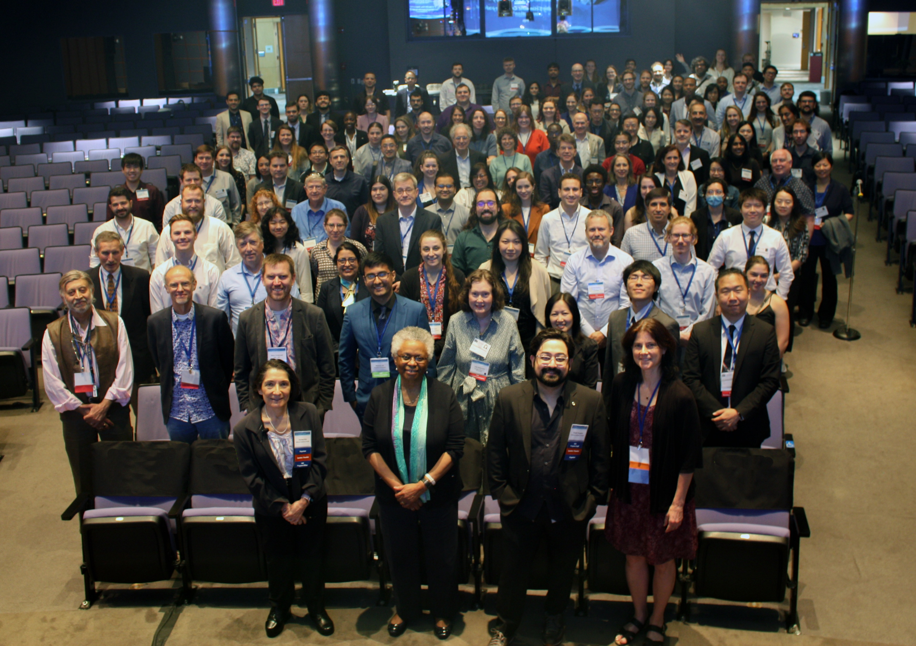
Training Grantees Meeting
June 15-16, 2023 Natcher Conference Center, Bethesda, MD
223 attendees
  140 trainees
  59 PIs and administrators
108 completed post-meeting survey
>90% had an enjoyable and productive time at TGM and would recommend it to their peers!
Thank you for participating!
Next meeting: June 12-13, 2025
Let us know thoughts/ideas

Slide 7
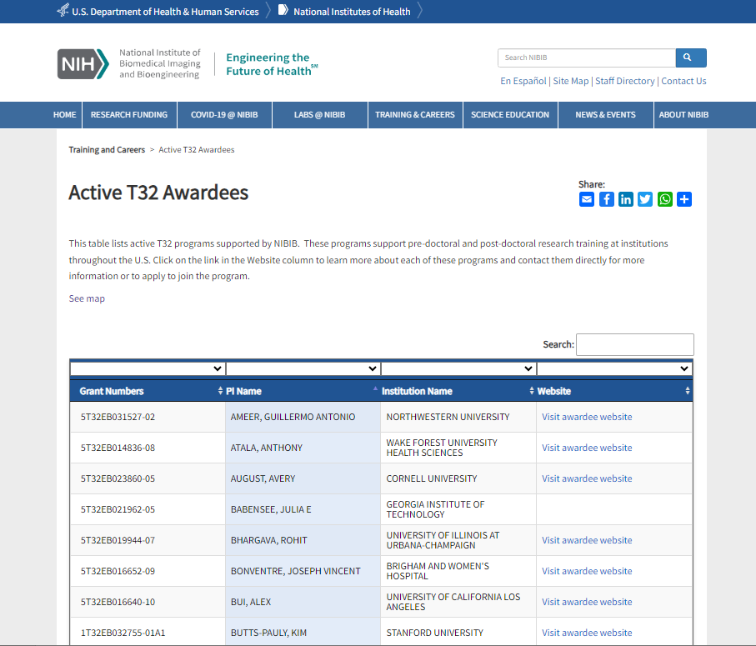
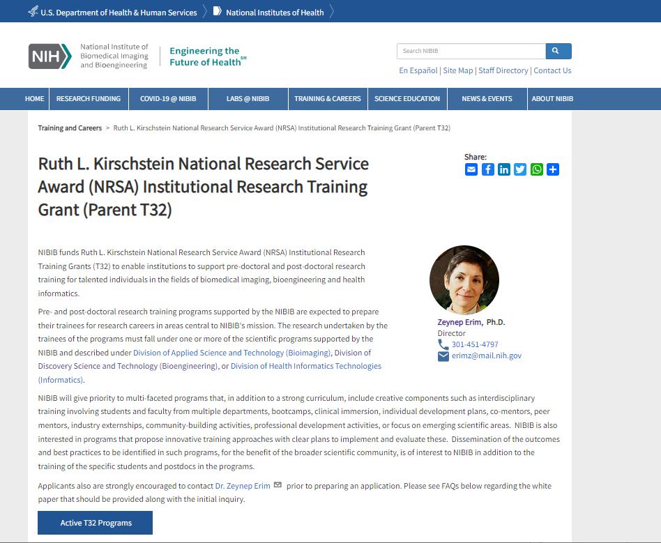
Websites
Linked from our T32 page
Please forward your link, if missing

Slide 8
Share Your Accomplishments with Us
Of your program or your trainees
Let us know at least 2 weeks before publication
Disseminate your work through news releases and post on EurekAlert, NIBIB Facebook, Twitter, LinkedIn and YouTube.
Strengthen our programs
Let your PO know

Slide 9
Reminders/updates
Additional T32 slots awarded in 2022
  We expect the second year of trainees appointed to these slots to be supported with funds other than the T32 or additional slots awarded in 2023
Next meeting to focus on Physician Scientist research training
  Dave Mankoff and Pam Woodard: the AAMC -- information and outreach for Physician Scientist Training Programs for Radiology
Need volunteers from predoctoral programs to pilot program presentations to ESTEEMED scholars
  Please reach out to me directly

Slide 10
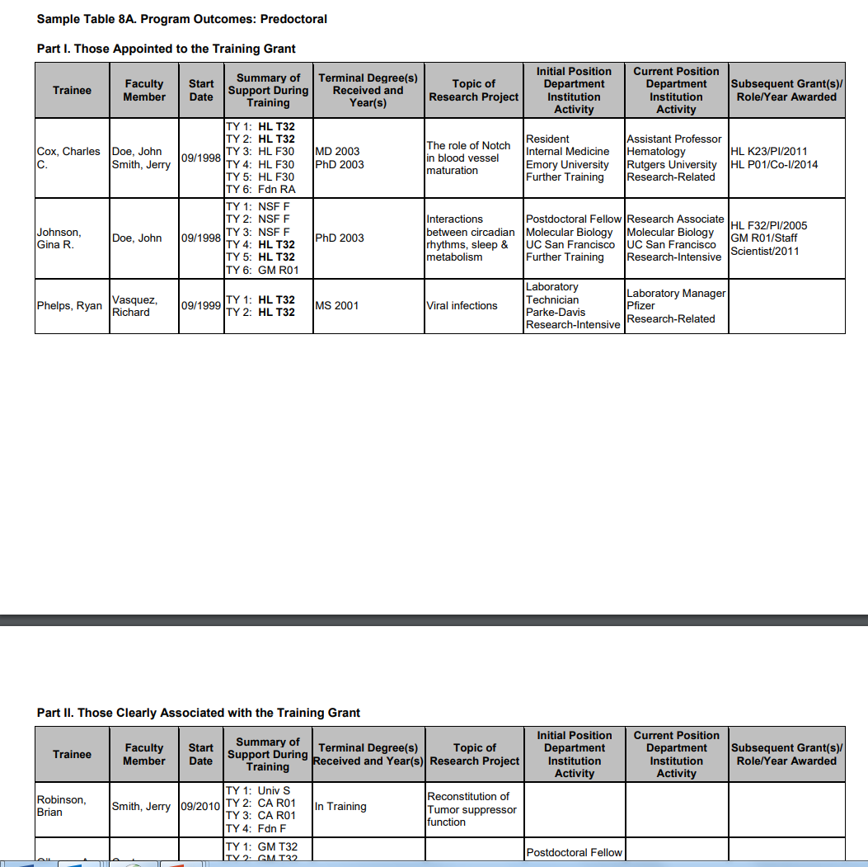
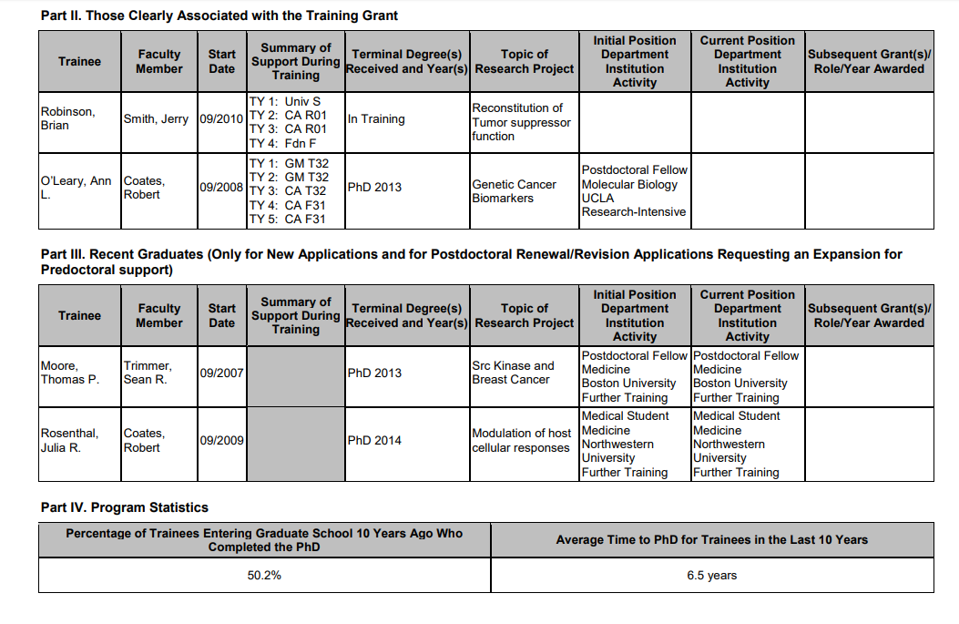
RPPR Reminder
Please follow instructions in NIH and Other PHS Agency Research Performance Progress (PDF)
Our FAQs have tips
Table 8A
  Helps us evaluate program outcomes
  Please be thorough, especially with subsequent positions,
    Workforce sector (i.e., academia, government, for-profit, nonprofit, other)
    Principal activity (i.e., primarily research, primarily teaching, primarily clinical, research-related, further training, unrelated to research)
Training Grantees Meeting 2018

